Slide 1

THE FUTURE OF EDUCATION Jadranko Batista e-mail: jadranko.batista@fpmoz.sum.ba
University of Mostar
Faculty of Science and Education
Study of Physics
DAAD

Slide 2

THE FUTURE OF EDUCATION
Analysis of the current situation
Examples
Projections for the future of education
Source: https://www.europeanbusinessreview.com/rethinking-future-higher-education/

Slide 3
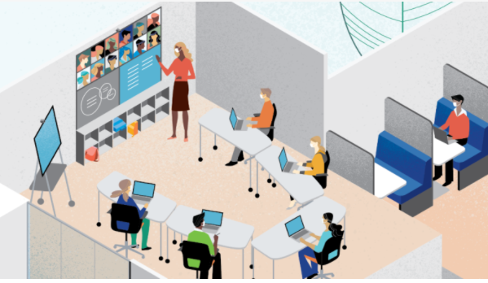
THE FUTURE OF EDUCATION
COVID-19 Accelerates Blended Learning
Physical space is for more than just learning. As one student put it, “The on-campus experience is a gazillion thing: your job, friends, campus events, being with others, trying new things and study sessions.”
Another said, “(I) would prefer a hybrid format… online interactions can’t substitute real, physical interactions.”

Slide 4
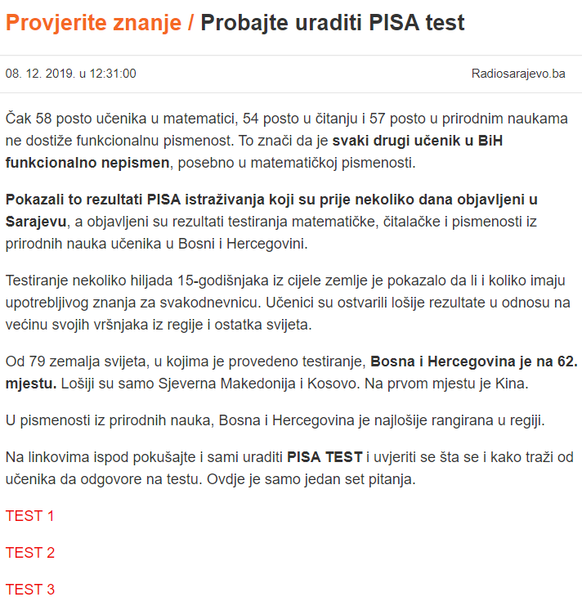
THE FUTURE OF EDUCATION
The current situation of the education system in and around the world - a comparison.
Quality of education and different programs for a compare the achievement of students.
https://ourworldindata.org/quality-of-education#piaac-programme-for-the-international-assessment-of-adult-competencies
PIRLS – Progress in International Reading Literacy Study
TIMSS – Trends in International Mathematics and Science Study
PISA is the OECD's Programme for International Student Assessment.
PIAAC – Programme for the International Assessment of Adult Competencies

Slide 5
THE FUTURE OF EDUCATION COMPETENCIES AND ACHIEVEMENT
Self-evaluation of physics graduates and evaluation by professors: Achievement of key competences for lifelong learning and additional specific sector competences by physics graduates. Analysis of strength and weaknesses of physics graduates on a sample of successful bachelor and master candidates from the University of Split was selected.

Slide 6
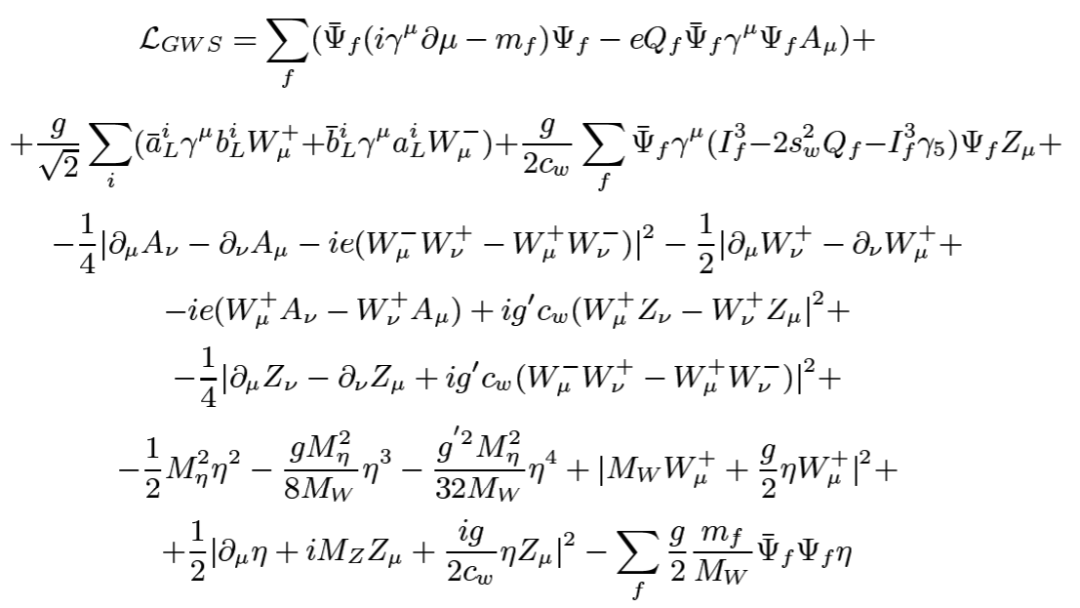
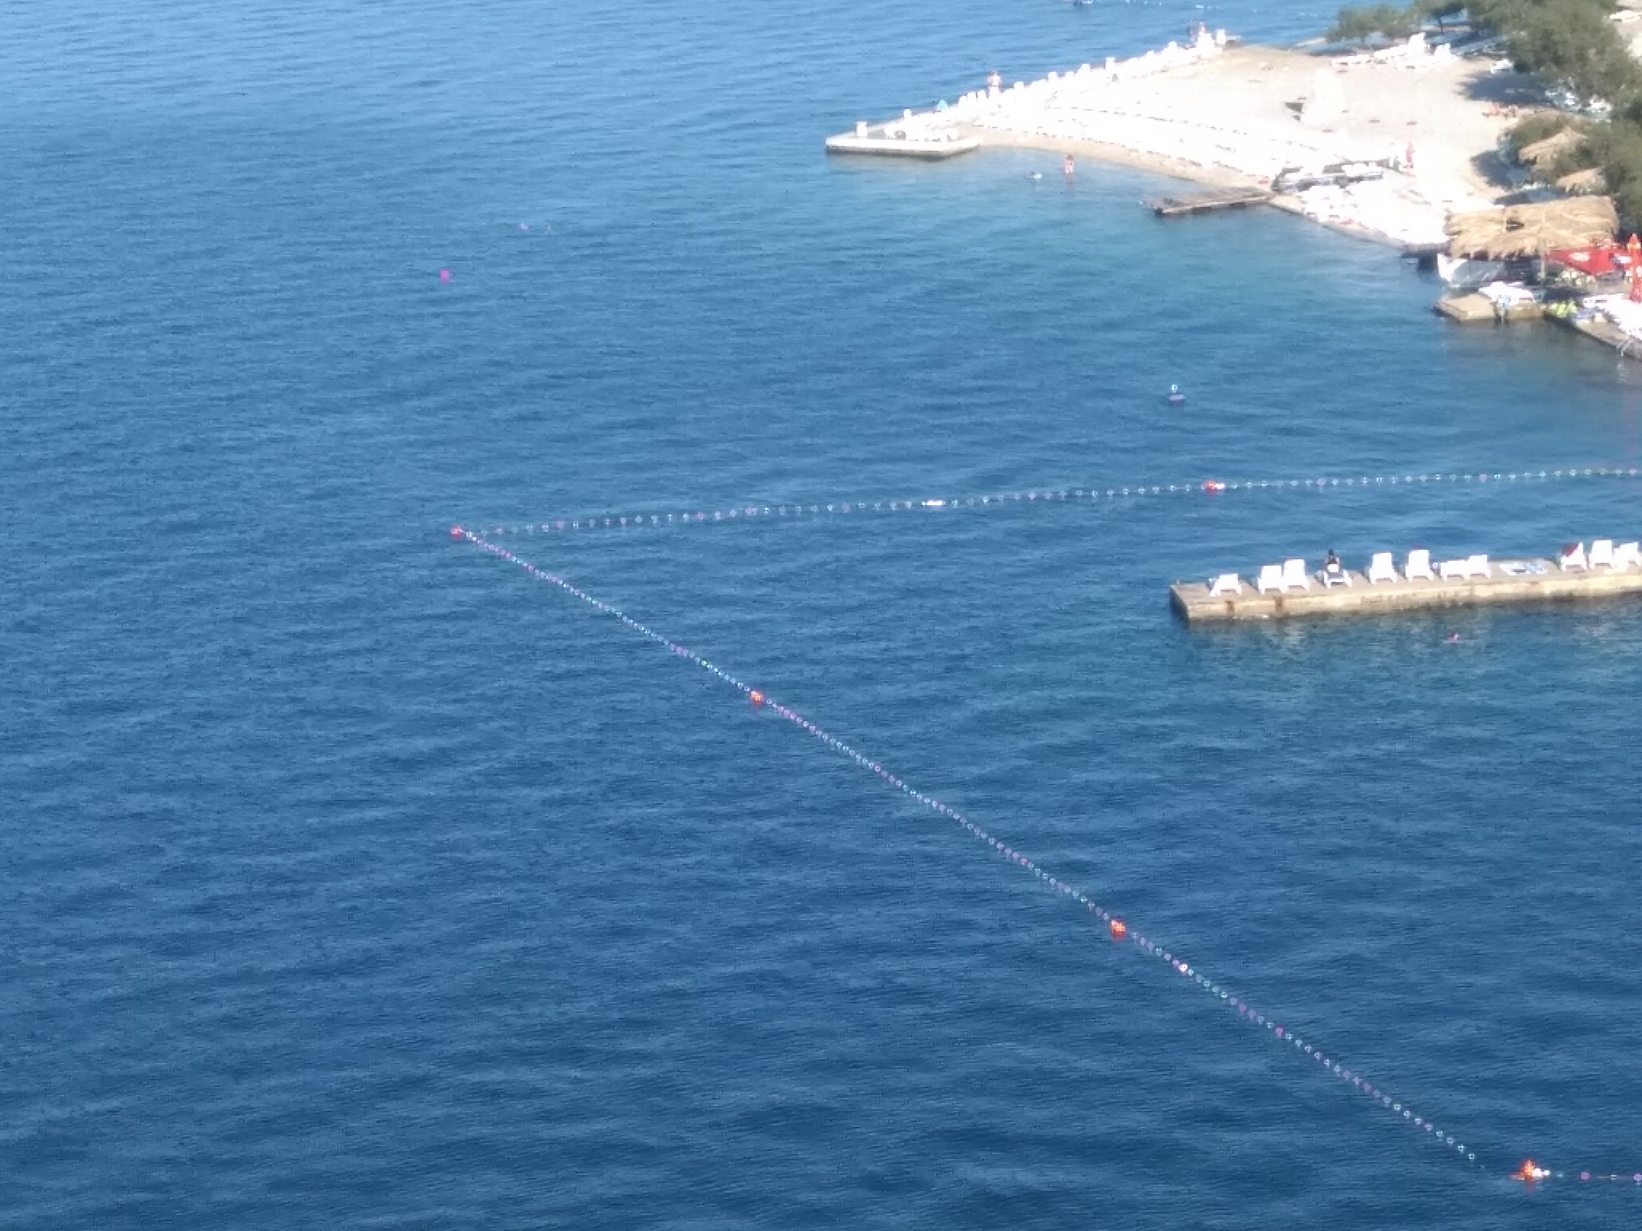
THE FUTURE OF EDUCATION
Science and education related to everyday situations.
Models in education: simplicity versus complexity.

Slide 7
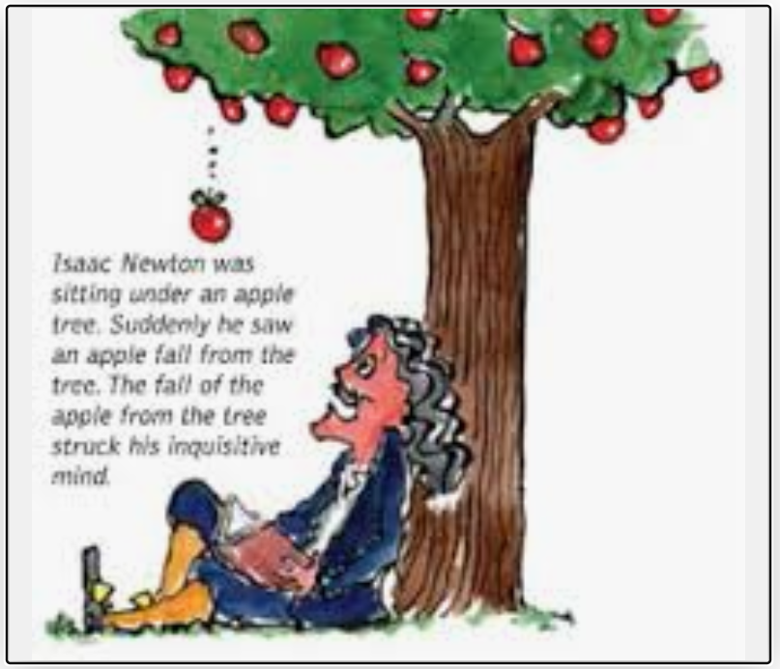



THE FUTURE OF EDUCATION Examples 1. – The fall & choice of model
What are the consequences
of the events?
Example:
What do you see in this video?

Slide 8
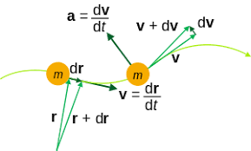
THE FUTURE OF EDUCATION Examples 1. – Instantaneous speed and instantaneous velocity
Is instantaneous velocity and instantaneous velocity a measurable quantity? Real vs abstract?
Instantaneous velocity can never be measured since there is no way in the real world to do anything instantaneously. All measurements take some amount of time to peform.

Slide 9
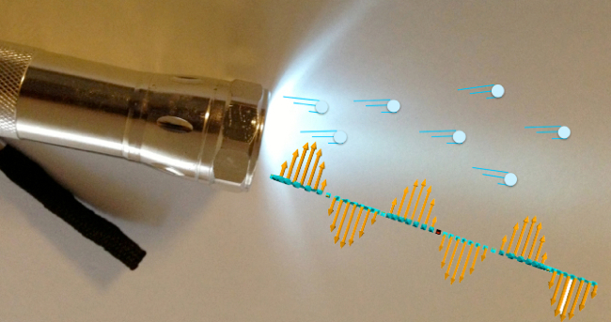
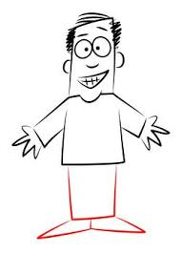
THE FUTURE OF EDUCATION Examples 2. – The nature of light: duality
Light: a particle or a wave, or both at the same time?
Person: basketball player or student, or both at the same time?
The properties
Source: https://www.wired.com/2013/07/is-light-a-wave-or-a-particle/

Slide 10

THE FUTURE OF EDUCATION Examples 3. – The time
Definition: Time is a magnitude that marks the duration of an event or the distance between two events.
The past, present and future; they are all equally real.
present
past
future
t
Memories
Knowledge
Experience
idea
part of the plan
Action
Choice

Slide 11
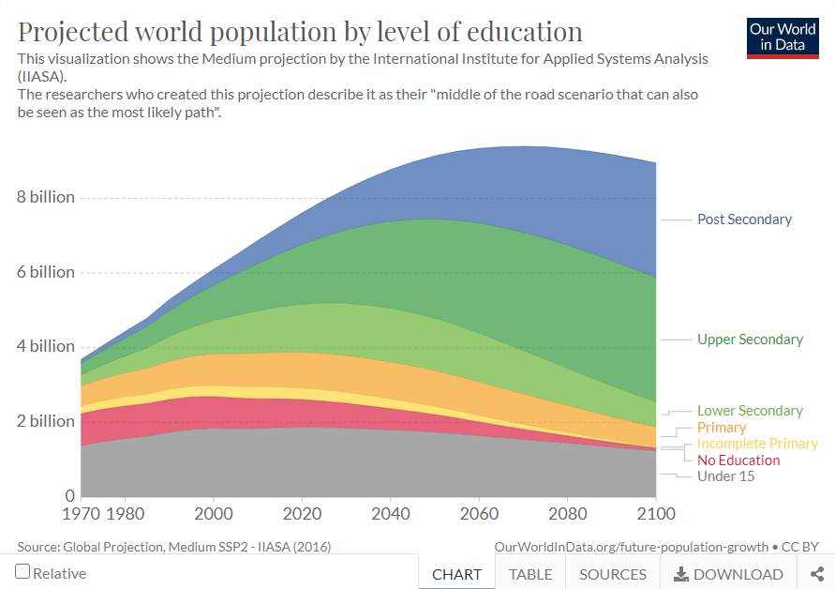
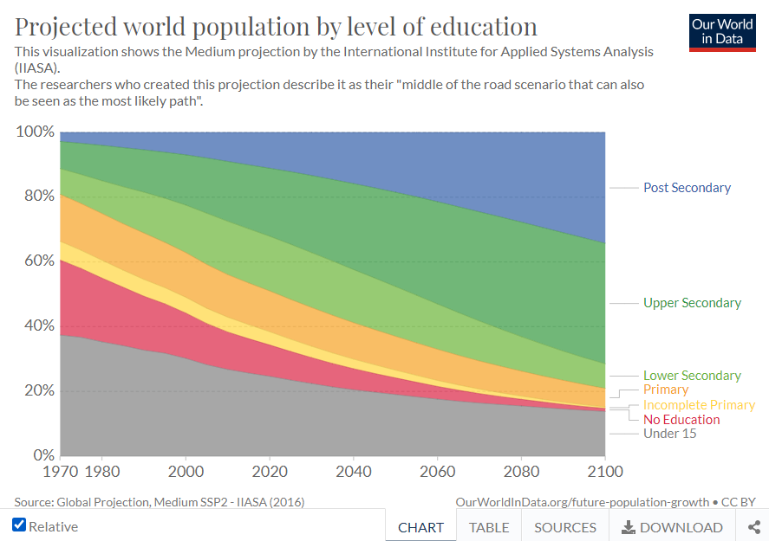
THE FUTURE OF EDUCATION
https://ourworldindata.org/grapher/future-population-projections-by-country?time=2100&country=BIH~HRV~MNE~SRB~MKD
https://ourworldindata.org/grapher/school-life-expectancy-from-primary-to-tertiary-education?region=Europe

Slide 12

THE FUTURE OF EDUCATION
The traditional education system is not adapted to students, their strengths and weaknesses.
The conventional education system has not changed towards personalized education.
The students are digital natives.

Slide 13
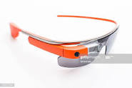
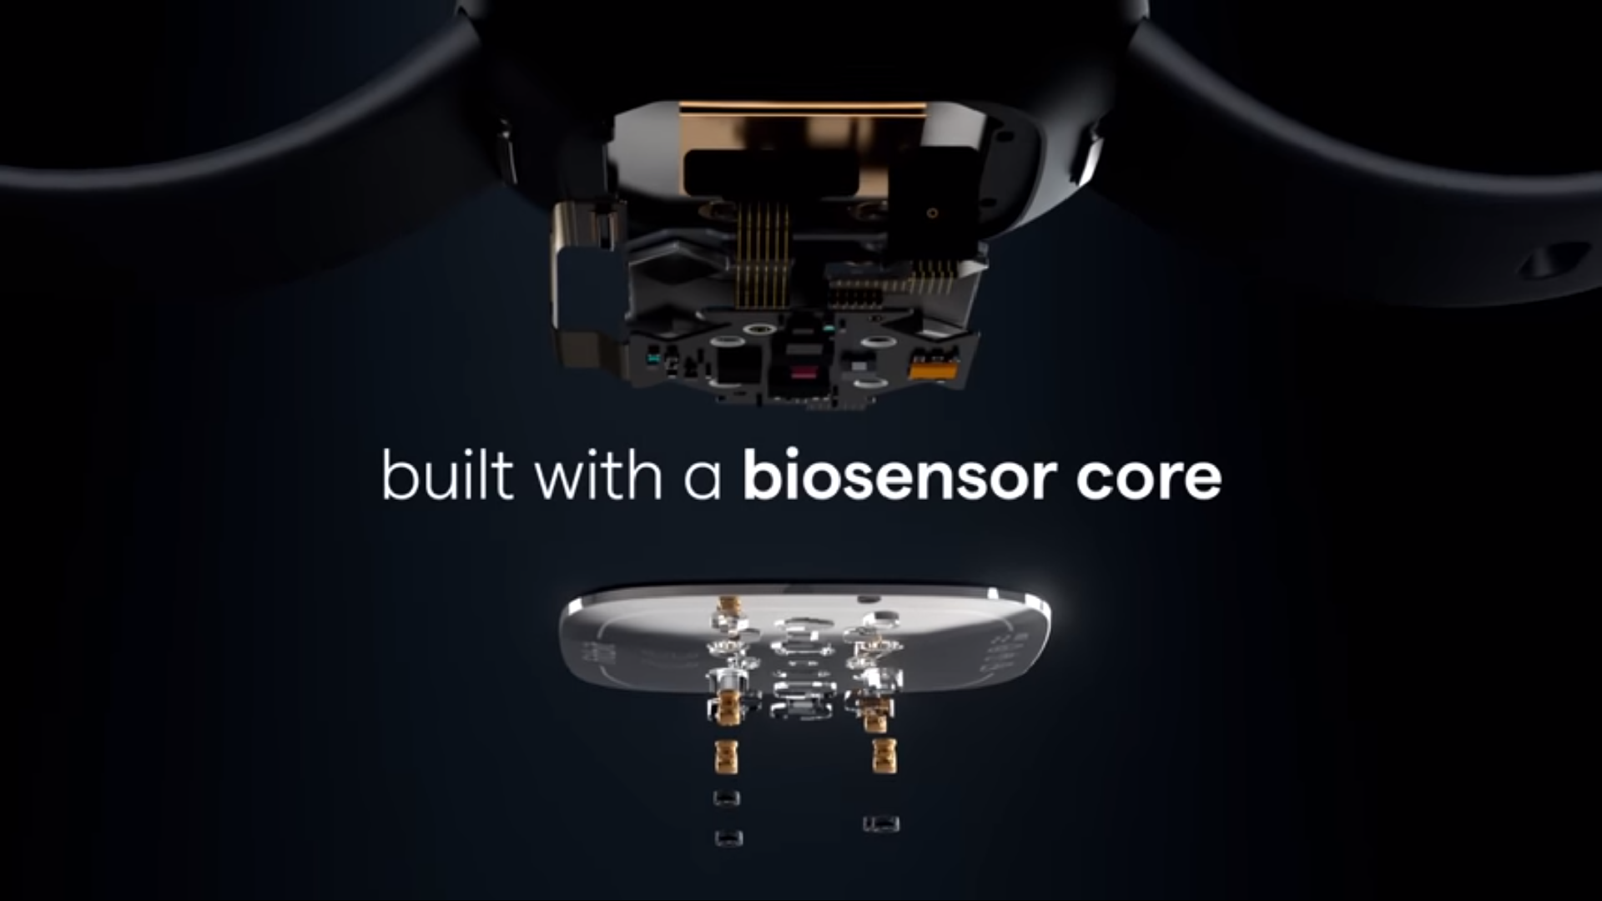
THE FUTURE OF EDUCATION
The integrity of different sciences disciplines to solve the problem(s).
Adapting educational systems to the use of digital technologies in teaching.
The first holographic concert: https://www.youtube.com/watch?v=LDMmcsH0fo8
Changing immutable educational programs to personal ones.

Slide 14
THE FUTURE OF EDUCATION
Trends Defines the Future of Education: 9 things that will change
Diverse time and place.
Personalized learning.
Free choice.
Project based.
Field experience.
Data interpretation.
Exams will change completely.
Student ownership.
Mentoring will become more important.
Fitbit sense

Slide 15
The Conclusion - Six ‘’C’’
Allow students to engage in:
Choice
Collaboration
Communication
Critical thinking
Creativity
Caring

Slide 16
Thanks
for your attention!

